Slide 1
陳佳楨
Chen Chia-Chen
🏠 台北市
✉ jameschen112001@gmail.com

Slide 2
Education
University at Buffalo, NY, United States 2021/01 – 2023/02
美國紐約州立大學水牛城分校
Master of Science in Computer Science and Engineering, GPA: 3.5/4
University of Taipei, Taipei, Taiwan 2014/09 – 2016/06
臺北市立大學
Master of Science in Chemistry, GPA: 88/100
Skills
Language：English(Fluent), Chinese(Native).
Programming Language：Python, C++, C#, SQL, JavaScript, HTML, CSS.
Tools：Visual Studio Code, Visual Studio, Jupyter Notebook, Git, Linux.
Computer Science: Machine Learning, Computer Vision, Database Design,
Web Development, Python Development.
Chemistry: Inorganic and Organic Synthesis, Organic Metal, Instrument Analysis.

Slide 3
Soft Skills
Problem Solving: Identified & implemented solutions to improve efficiency.
Teamwork: Collaborated with colleagues to complete projects on-time.
Responsibility: Managed multiple projects, meeting deadlines & delivering high-quality results.
Job Experience
Research Assistance, National Taiwan University, Taipei, Taiwan
2016/09 –2019/09
Teaching Assistance, National Taiwan University, Taipei, Taiwan
2016/09 –2017/06
Notes:
Research Assistance, National Taiwan University, Taipei, Taiwan 2016/09 –2019/09
Designed and synthesized novel borenium cations featuring a non-innocent 2-coordination ligand, capable of cooperatively activating carbon-oxygen double bonds and amine-boranes. Characterized the borenium compounds by crystallography and NMR spectroscopy.
Implemented the DFT methodology within the Gaussian computational framework to calculate compounds' HOMO and LUMO energies, identifying transition states, and assessing electronic properties, providing valuable insights into chemical behaviors.
Teaching Assistance, National Taiwan University, Taipei, Taiwan 2016/09 –2017/06
Served as a teaching assistant for general chemistry laboratory courses, instructing more than 30 students in the principles of chemical experiments and equipment operation.

Slide 4
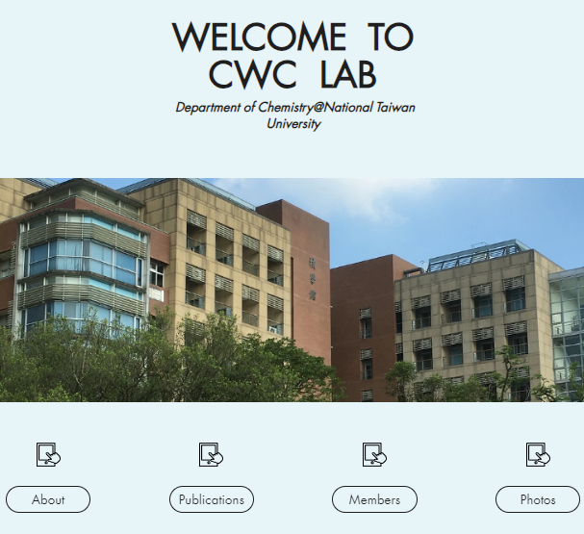
Project
Web Design for Laboratory
Purpose:
The website's purpose is to boost the lab's visibility and inform visitors about our research areas, projects, and activities.
Notes:
Motivation:
The motivation behind this project was to address the challenge of noisy and inconsistent data that often affects the performance of deep learning models. Traditional noise reduction techniques didn't seem to fully capture the complexity of the noise patterns, so I decided to design an adaptive median filter that could better handle varying levels of noise."
Development Process: "I started by researching and implementing the adaptive median filter algorithm in Python. This filter dynamically adjusts its filtering window size based on the local noise level in the image. This way, it can effectively preserve edge details while effectively reducing noise. Once the filter was working accurately, I integrated it into a CNN architecture using the Tensorflow API to create a robust end-to-end deep learning model."

Slide 5
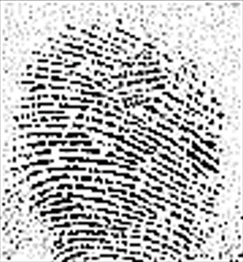
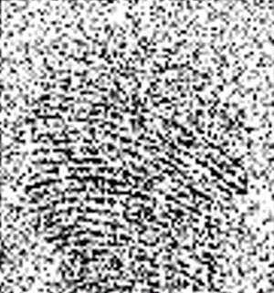
Projects
Adaptive Filter for Improving CNN Fingerprint Recognition
(Deep Learning Course)
Original Image
Gaussian noise (0.5^2)
Adaptive Median Filter | Without Filter
accuracy: 97.5% | 97.8%
(About the same)
Adaptive Median Filter | Without Filter
74.2% | 40.5%
(Improved 83%)
Motivation:
Address the challenge of noisy and inconsistent data that often affects the performance of deep learning models.
Development Process:
Implementing the adaptive median filter algorithm in Python that dynamically adjusts its filtering window size based on the local noise level in the image for effectively preserve edge details while effectively reducing noise.
Integrated it into a CNN architecture using the Tensorflow API.
Result:
The result shows an improvement of 83% in accuracy.
Notes:
Motivation:
The motivation behind this project was to address the challenge of noisy and inconsistent data that often affects the performance of deep learning models. Traditional noise reduction techniques didn't seem to fully capture the complexity of the noise patterns, so I decided to design an adaptive median filter that could better handle varying levels of noise."
Development Process: "I started by researching and implementing the adaptive median filter algorithm in Python. This filter dynamically adjusts its filtering window size based on the local noise level in the image. This way, it can effectively preserve edge details while effectively reducing noise. Once the filter was working accurately, I integrated it into a CNN architecture using the Tensorflow API to create a robust end-to-end deep learning model."

Slide 6

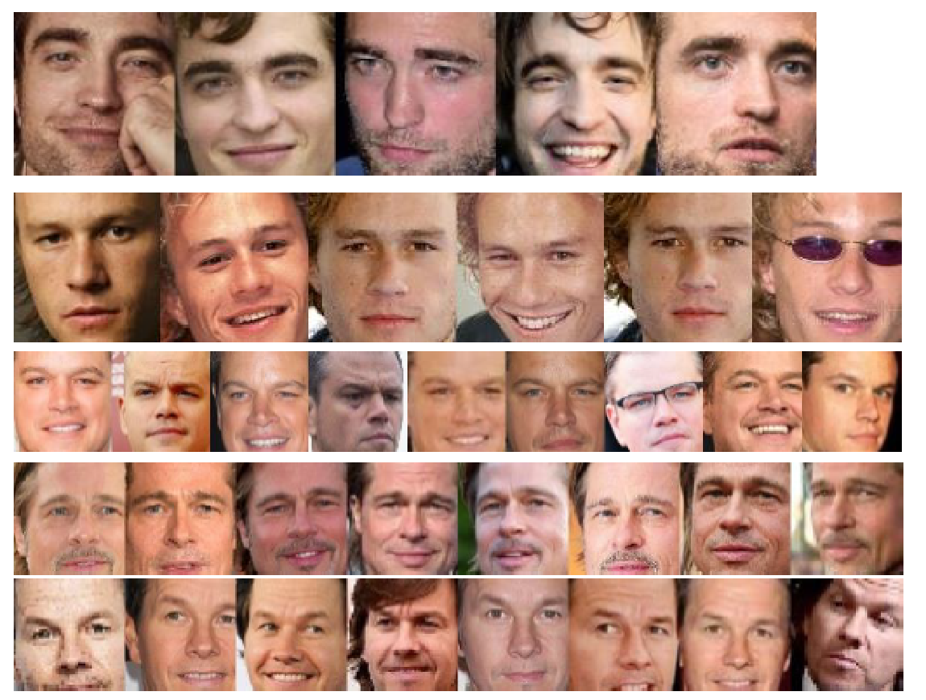
Projects
Face Detection and Clustering
(Computer Vision Course)
Objective:
The project aims to create an advanced face detection model, optimize clustering, and integrate them for accurate face grouping in images.
Development Process:
The first part of this project involves detecting and extract face regions in each image using the OpenCV API and convert features into numerical feature vectors that can be used for clustering.
The second phase involves clustering the detected faces using the K-means algorithm.
Result:
The program achieves accurate clustering with a 100% success rate.
Notes:
Motivation:
The motivation behind this project was to address the challenge of noisy and inconsistent data that often affects the performance of deep learning models. Traditional noise reduction techniques didn't seem to fully capture the complexity of the noise patterns, so I decided to design an adaptive median filter that could better handle varying levels of noise."
Development Process: "I started by researching and implementing the adaptive median filter algorithm in Python. This filter dynamically adjusts its filtering window size based on the local noise level in the image. This way, it can effectively preserve edge details while effectively reducing noise. Once the filter was working accurately, I integrated it into a CNN architecture using the Tensorflow API to create a robust end-to-end deep learning model."

Slide 7

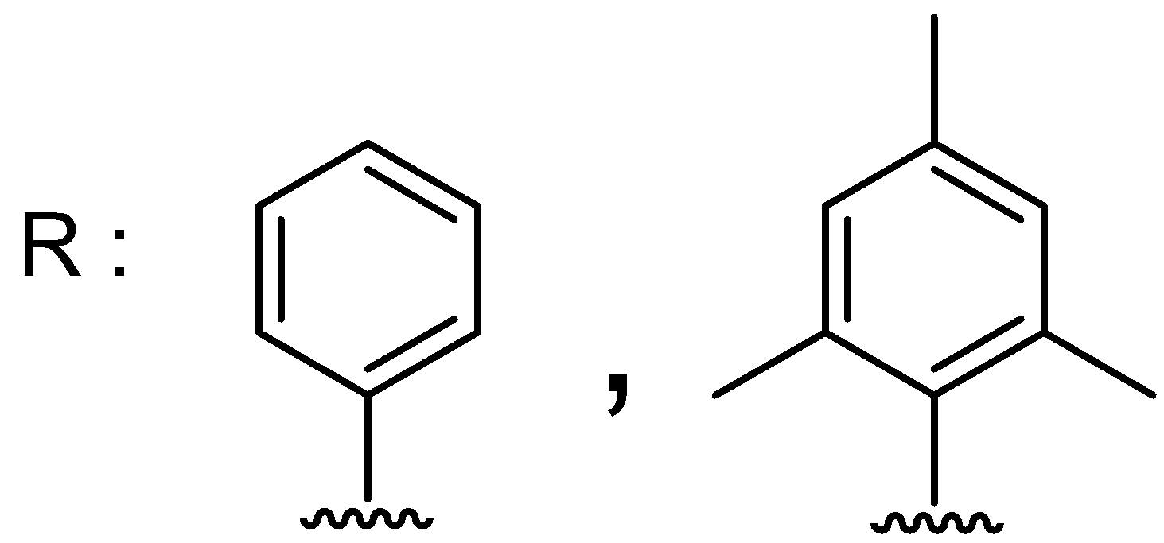
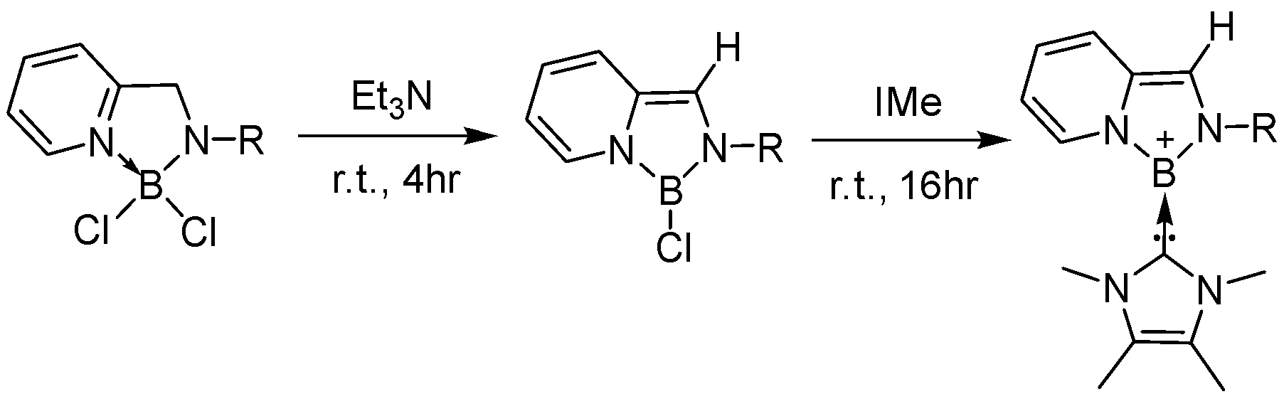
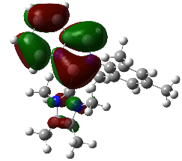
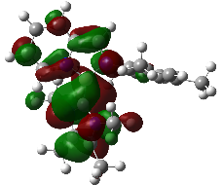
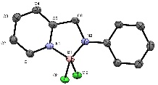
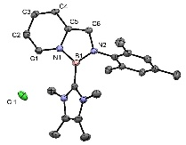
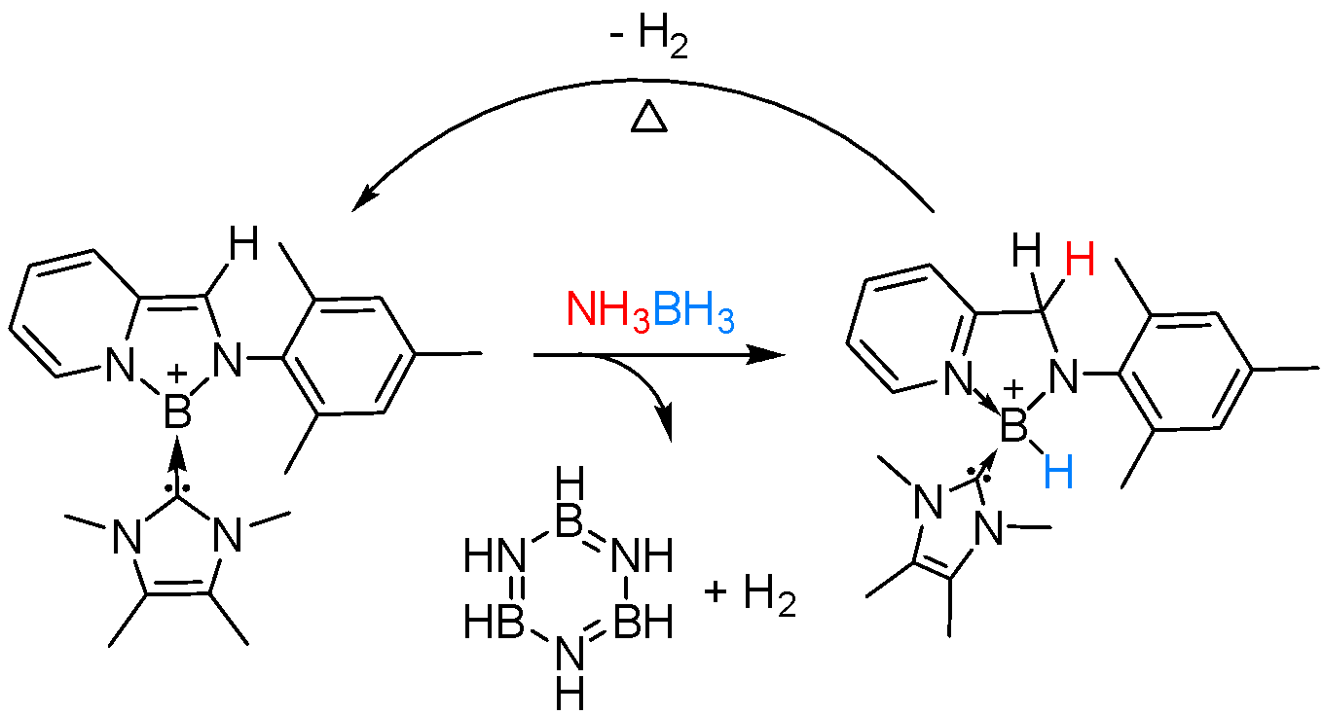
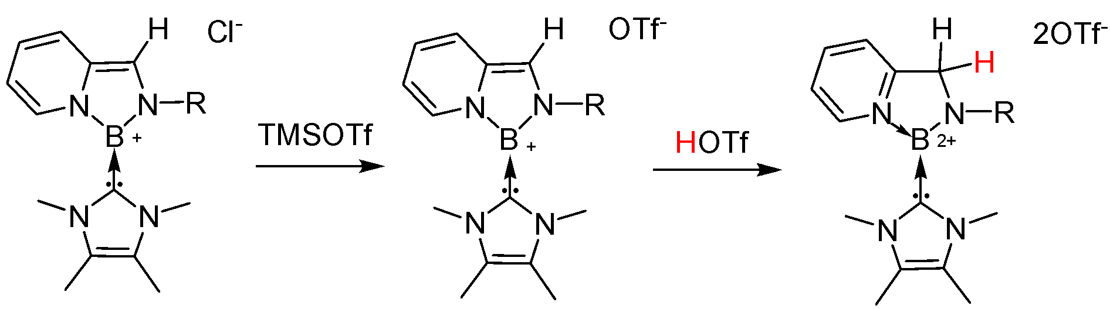
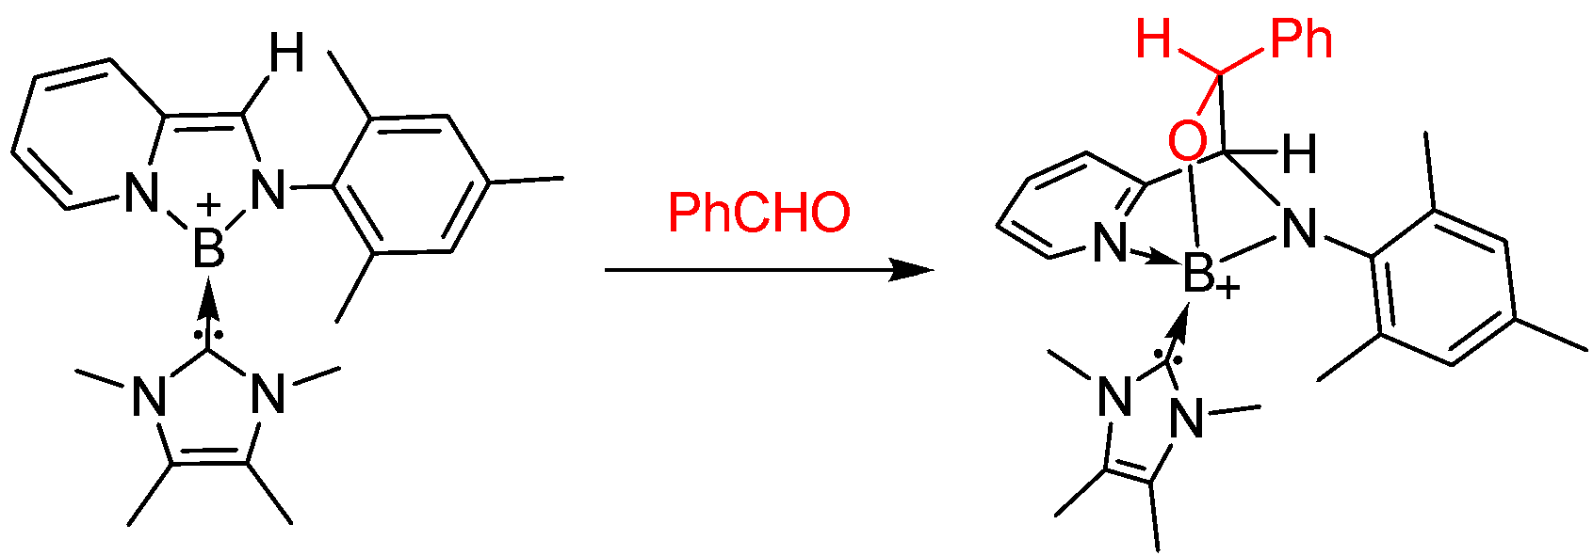
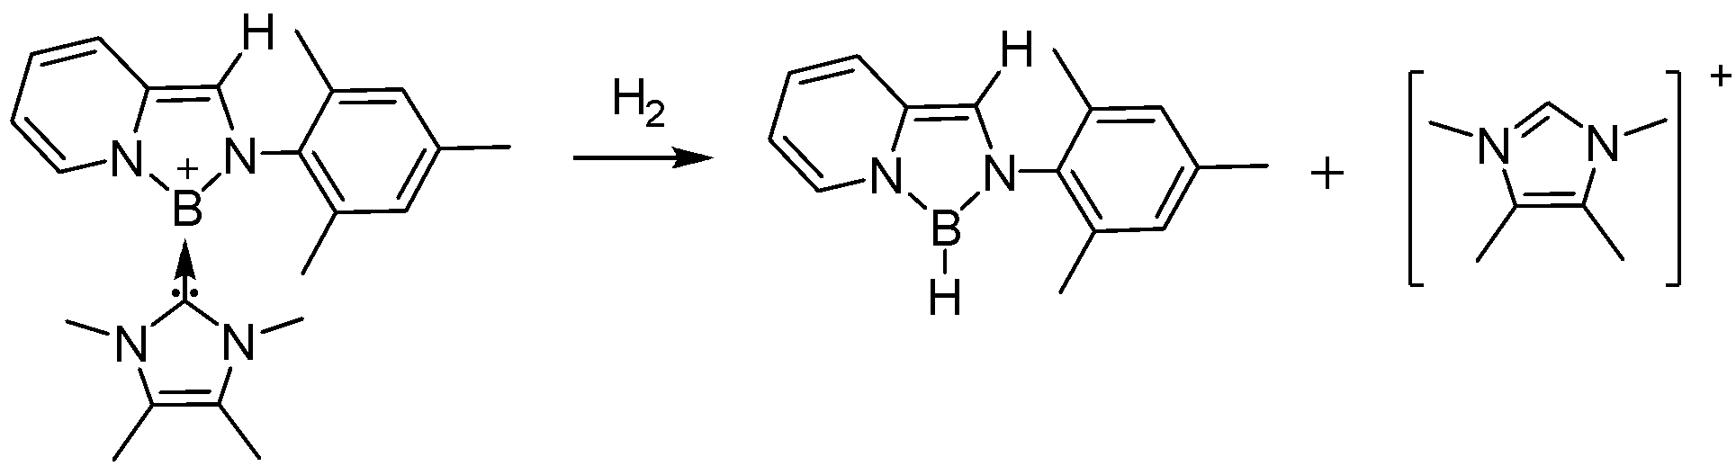
Metal-Ligand Cooperation in Borenium Catalyst
Chia-Chen Chenª, Ching-Wen Chiu^{a,*}
ªDepartment of Chemistry, National Taiwan University, No.1, Sec. 4, Roosevelt Rd., Taipei, 10617 (Taiwan)
cwchiu@ntu.edu.tw
Abstract
The combination of boron and non-innocent ligand has been explored by Milstein in 2016.¹ However, no catalytic reaction has been achieved with such boron-ligand cooperation interaction. In this work, we report a stable borenium cation featuring a non-innocent ligand that can cooperatively activate C=O double bond and amine-borane. The synthesis and reactivity of the borenium cation will be discussed.
Introduction
The combination of non-innocent ligand and transition metal has resulted in a lot of important breakthroughs in transition metal based catalysts. While some of the non-innocent ligands participate in electron transfer process, some are involved in activation of subtracts with metal center cooperatively. Although the strategy has led to great success in d-block metals, the incorporation of non-innocent ligand to main group complexes has less developed. In the past few years, tricoordinate boron cation, borenium cation has received a lot of attention because of its potential application in catalytic hydrosilylation and hydrogenation.^{2,3} Since the borenium cation is too reactive, most of the works use bulky ligands like 2,6-lutidine and sterically demanding NHCs, and bulky substituents like mesityl and cyclopentadienyl to protect the boron center kinetically. Here we present another way to prepare catalytically active borenium center by placing the boron center in an aromatic ring generated from non-innocent ligand.
Results
Synthesis
Theoretical calculation
¹¹B NMR 8.51 ppm
¹¹B NMR 19.45 ppm
¹¹B NMR 15.9 ppm
Computed HOMO & LUMO
Amine-Borane dehydrogenation
Bond length(Å) | Boron | Borenium
N1-C1 | 1.35 | 1.40
C1-C2 | 1.36 | 1.35
C2-C3 | 1.39 | 1.43
C3-C4 | 1.38 | 1.35
C4-C5 | 1.38 | 1.44
C5-N1 | 1.34 | 1.42
C5-C6 | 1.49 | 1.35
Borane Dication
¹¹B NMR -2.1(d) ppm
Conclusion
A non-innocent ligand supported borenium cation has been successfully synthesized and it’s structure has been characterized by crystal data. Protonation of the borenium cation took place at the ligand led to a tricoordinate boron dication which might have some reaction potential. Although the borenium complex is not able to catalyze hydrosilylation of benzaldehyde and decomposes slowly under H₂, the non-innocent ligand and boron center cooperatively promote the dehydrogenation of amine-borane at room temperature. The resulting boronium cation can be heated to 60 ºC to regenerate the original borenium cation.
Reactivity toward Aldehyde
¹¹B NMR 28.20 ppm
Reactivity toward H₂
¹¹B NMR 28.17 ppm
References
1. U. Gellrich, D. P. Yael, , L. J. W. Shimon, and D. Milstein, J. Am.
Chem. Soc., 2016, 138, 13307.
2. S. E. Denmark* and Y. Ueki, Organometallics, 2013, 32, 6631.
3. J. M. Farrell, J. A. Hatnean, and D. W. Stephan, J. Am. Chem. Soc.,2012, 134, 15728.
¹¹B NMR 1.54(d) ppm

Slide 8
Thank You

